Slide 1

Identify project objectives and tasks
In conclusion, it aims to find and build a well-trained model to accurate predict the commodity price.
Linear regression and LSTM model
Feature selection
Different parameter combination for each model.

Slide 2

Deep Learning for Commodity Price Prediction
Haoming Guo
201600384

Slide 3
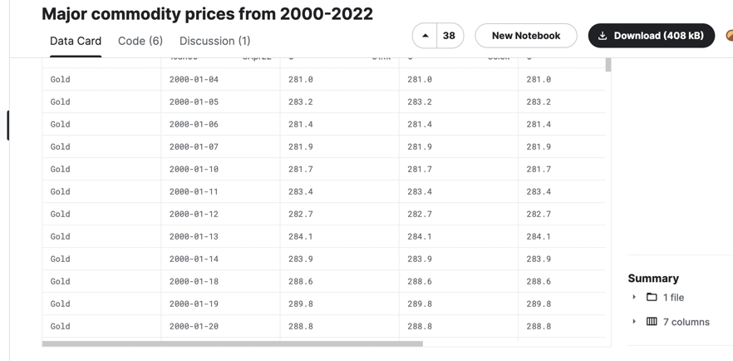
Introduction
Since this project is build in .ipynb file and run in Google Colab without any UI interface or UX, this PowerPoint will contain all contents we need in the video.
Identify project objectives and tasks
Dataset introduction.
Analyze the goals of the project Learn about datasets.
Talk about Possible model
the project code implementation
Import and Preprocess the dataset.
Build the model.
Train.
Predict.
Evaluate (MSE: Mean square Error)

Slide 4

Dataset introduction
This Kaggle dataset is about six major commodity price (Brent Oil, Gold, Natural Gas, Nickel Palladium, US Wheat) in the period from 2000 to 2022.
This dataset is a .csv file with 6 columns (Symbol, Date, Open, high, Low, Close). It is a time-series data from market.

Slide 5

Analyze the goals of the project
What we can do based on this project?
Predict the movement direction base on the data.
Predict the precise price base on the data.
Predict the market and develop a successful trading strategy (based on knowledge from COMP226)
The hidden Task behind above topics: (based on deep learning aspect)
The easiest task is predicting the price change direction.
The second easy task is developing a trading strategy (which is same as the first one since only need know about price is direction)
The most challenge topic is predicting the exact price (direction + value)

Slide 6

Talk about Possible models
Now it is cleat that I need to build a regression model to predict the exact commodity price.
The model may be possible:
Linear regression
RNN (LSTM) for time-series data
The model used for price prediction but not suitable for this task:
Decision tree (not suitable) data type not num. (room type for room price)
Random forest (not suitable) data type not num.
Logistic regression (not suitable) bi-classify for direction.
SVC from scikit-learn (not suitable) bi-classify.

Slide 7
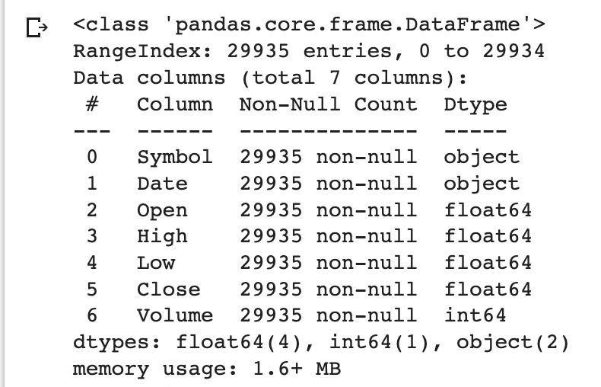
Now is project implementation details
Import dataset.
Use Pandas read and store in the dataframe which is easy to operate.
Output the dataframe information to overview.
Preprocess the dataset.
Divide the data into different commodity
MinMax Normalization in range (0,1)
Visualize some features

Slide 8
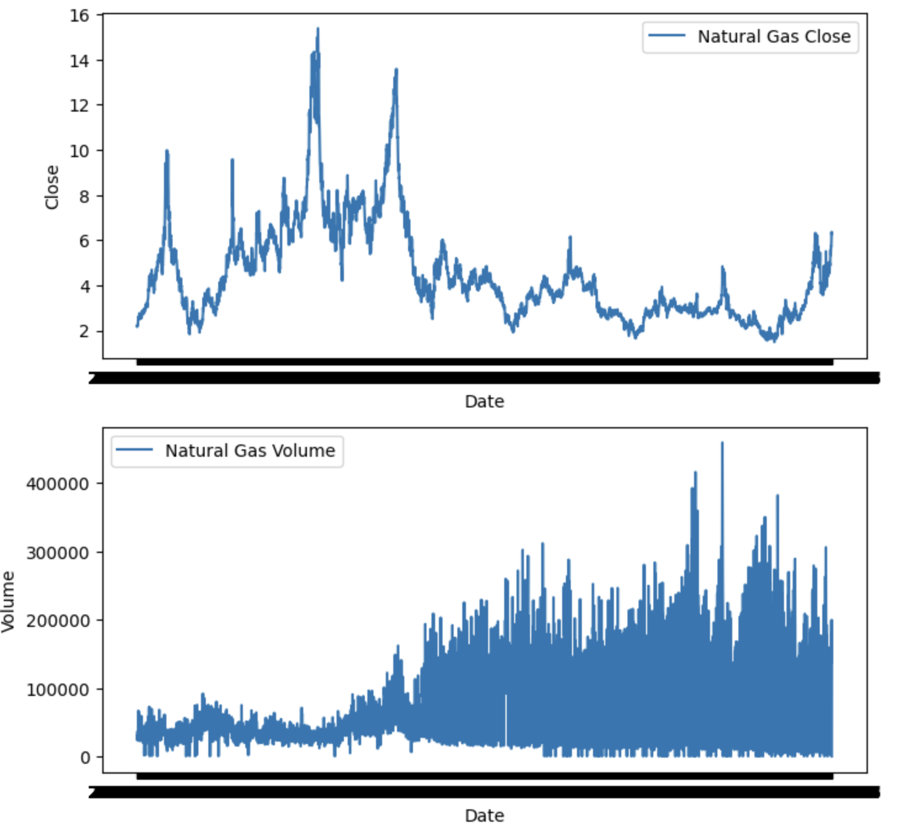
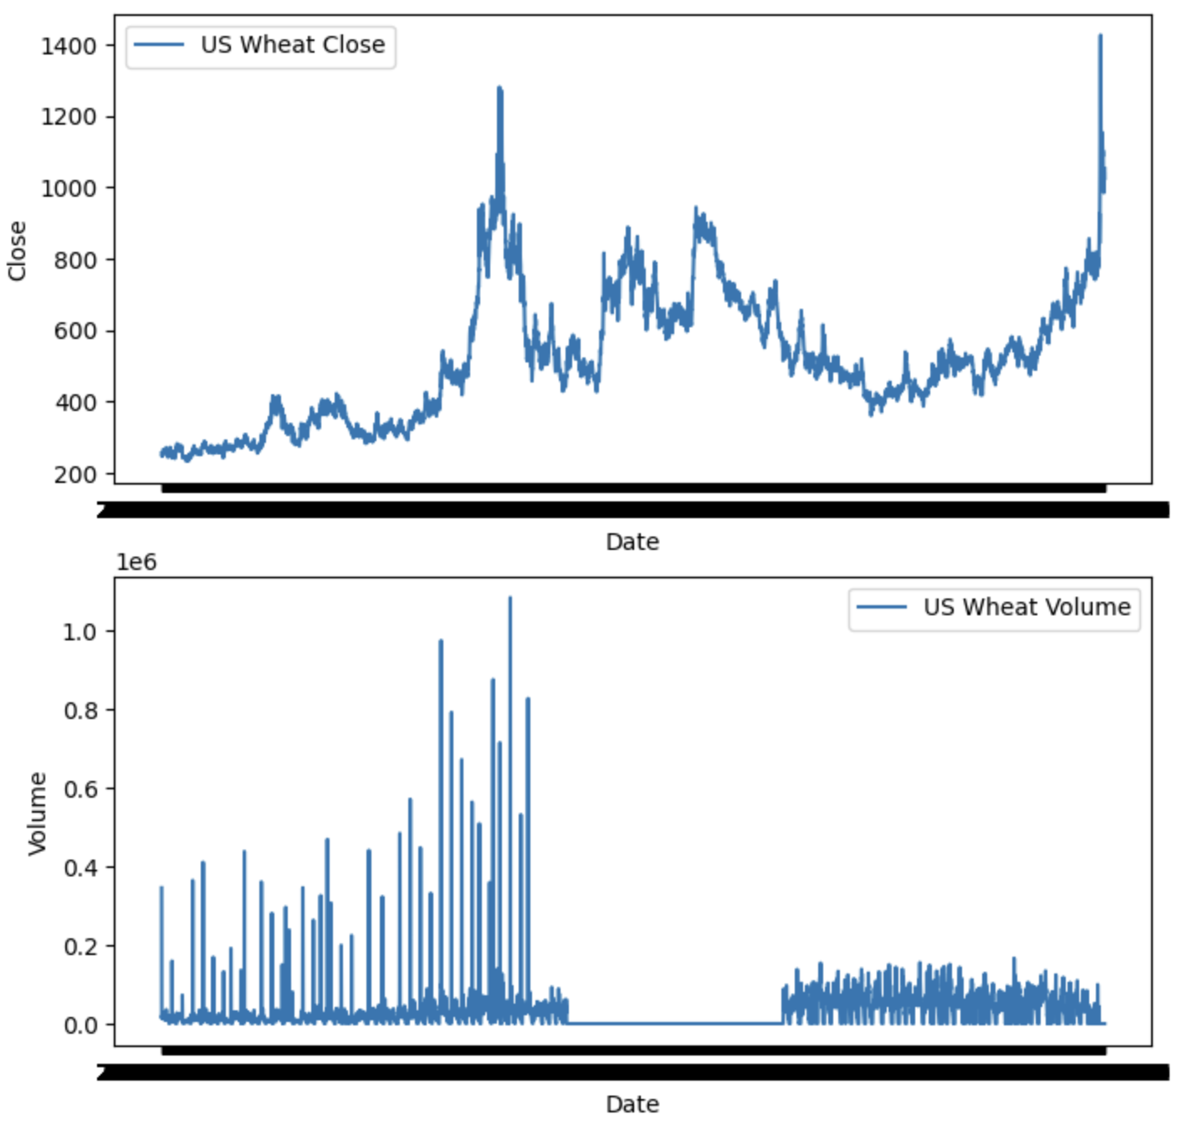
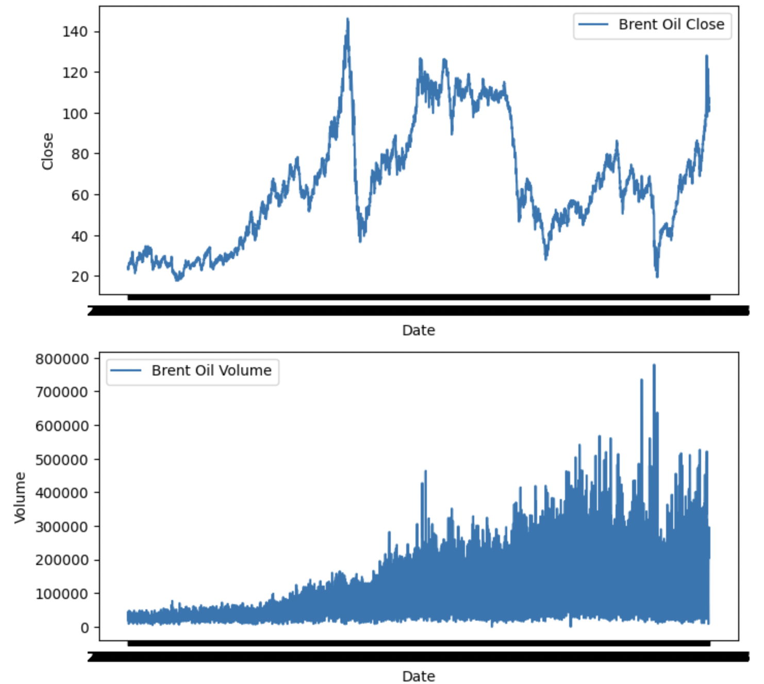
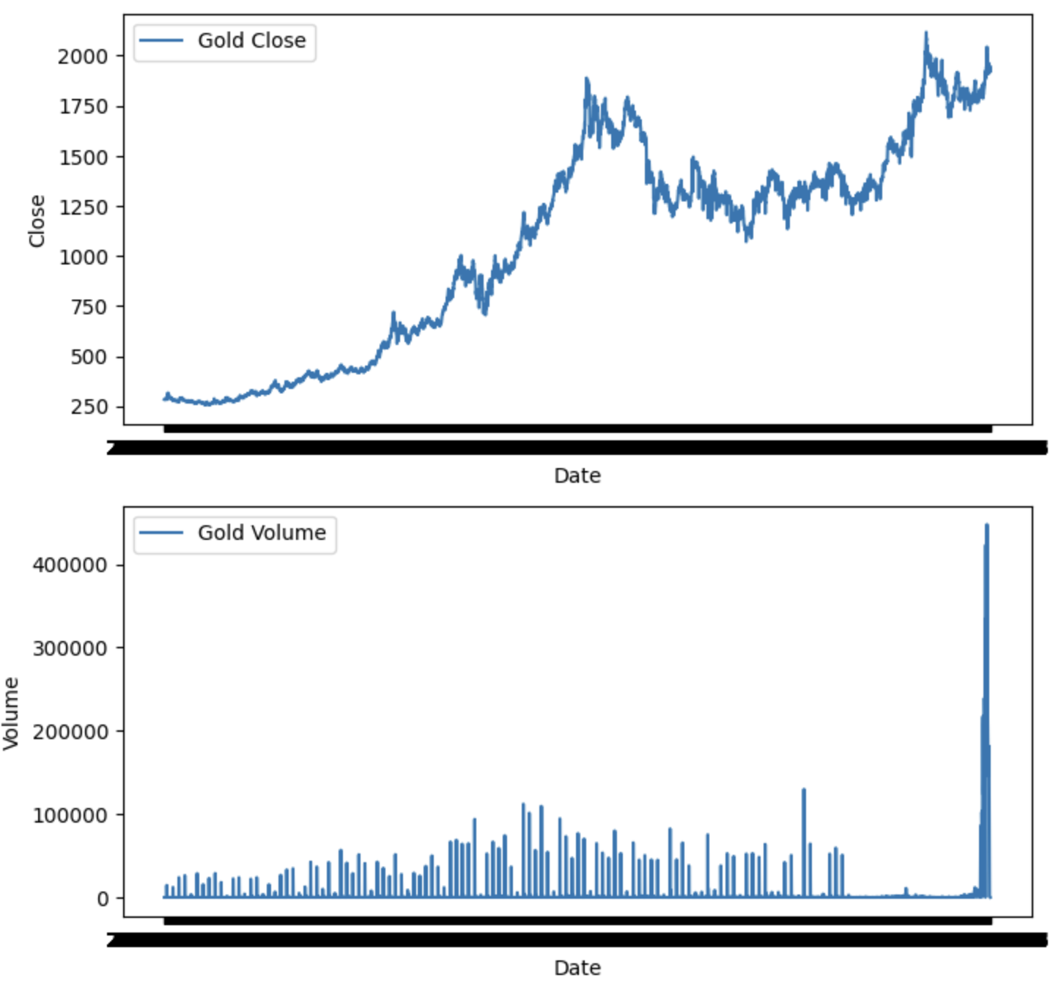
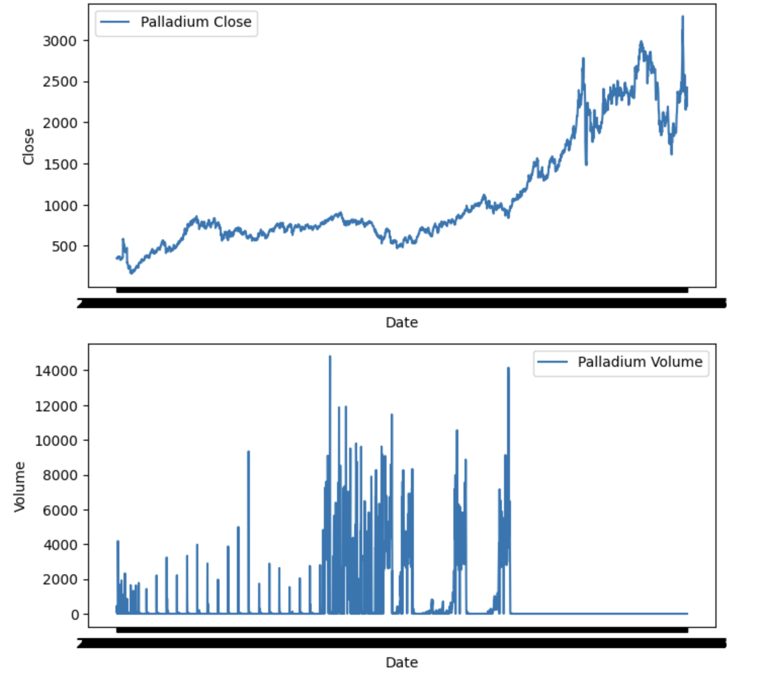
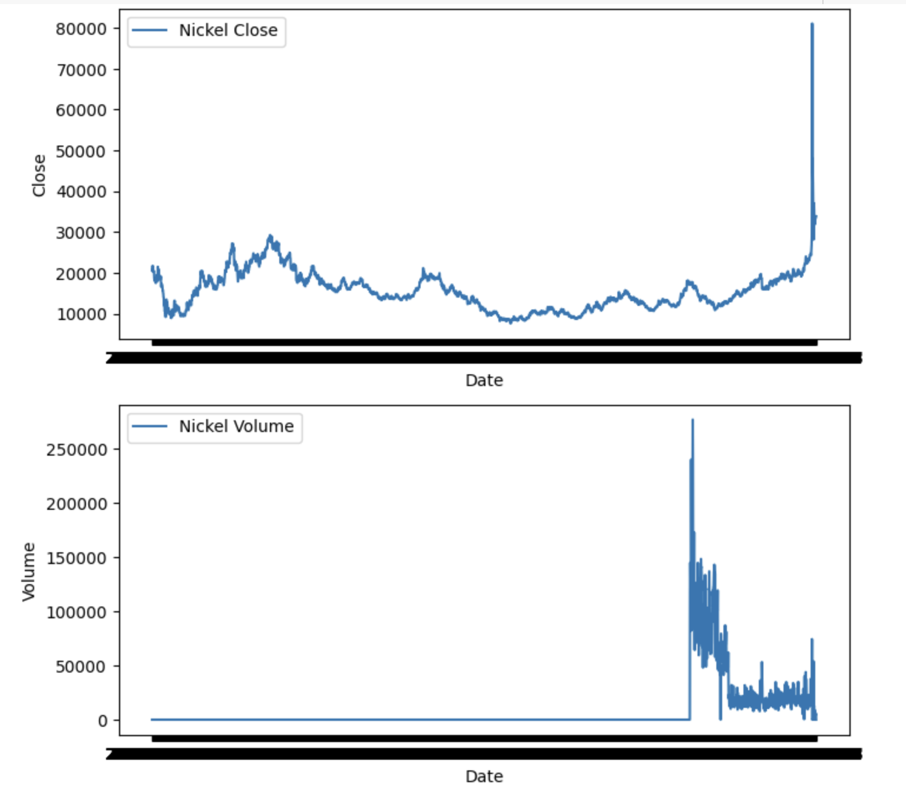
Visualization
Since the prices are similar in one day (open, close, high, low), meanwhile, it is not clear the volume data is relatively helpful or not.
It is helpful to visualization the price with the volume, to check if any potential relationship behind them.
Here are figures about close price and volume for six commodity.

Slide 9
Features preprocess and preparation
What features will be used?
Use price data with certain lookback as features
How to split the train and test dataset? What is the ratio of it?
split the train and test dataset as ratio of 8:2

Slide 10
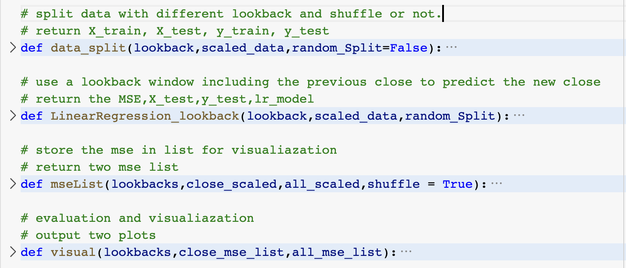
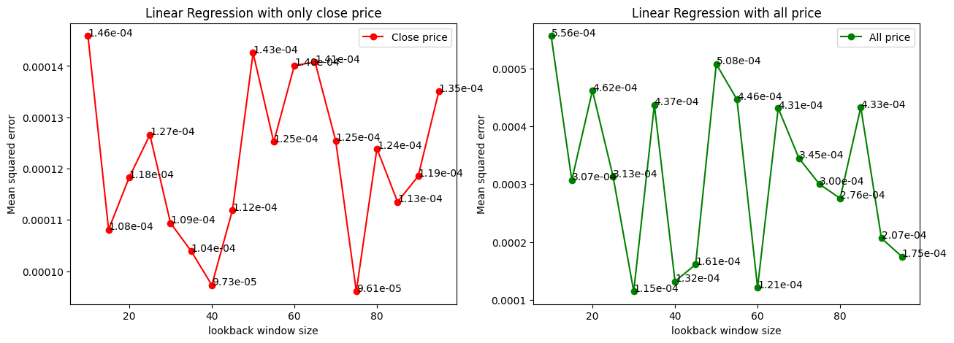
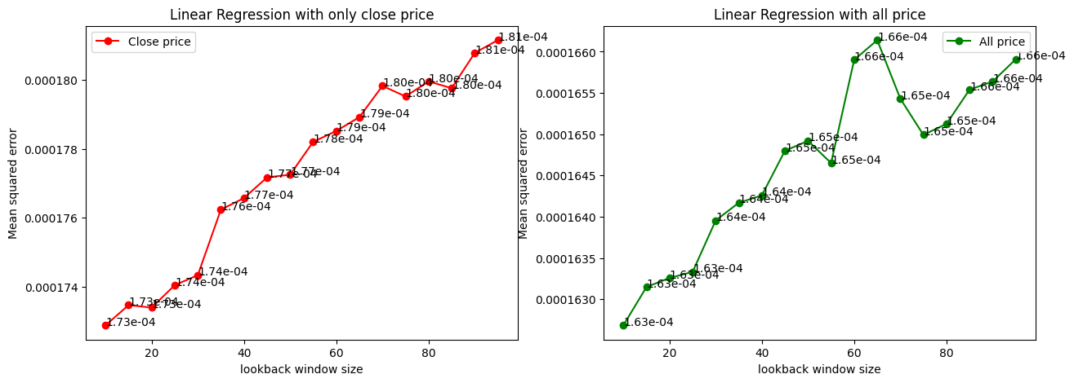
Implement the Linear Regression for this dataset
Use US Wheat data first
Build the model.
Import from sklearn.linear_model
Train.
Use what kinds features?
Data split shuffled or not?
Predict and Evaluate
MSE: Mean square Error
Visualization
Unshuffled data show the monotonicity in mse: possible reason: longer lookback it has, more specific period hidden rule it will learn, which does not have generalization properties

Slide 11
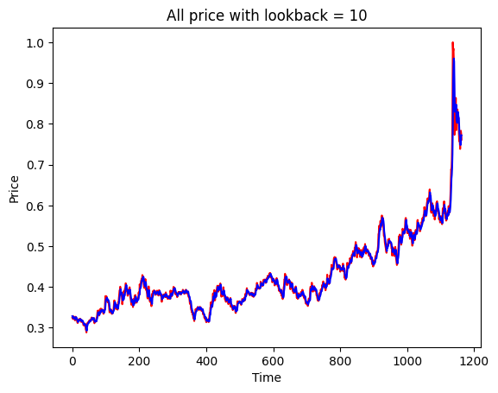
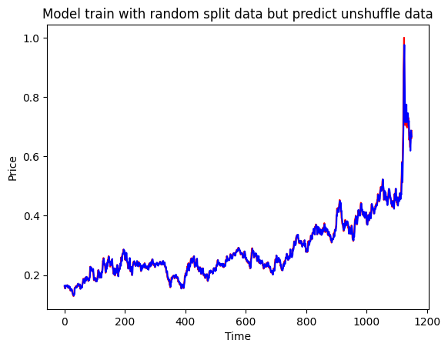
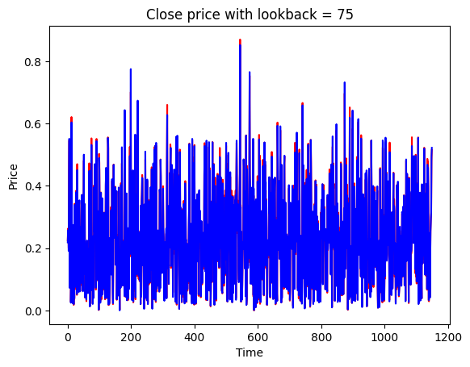
Check the best performance
It is clear that the best model for two situation (data shuffled or not) are:
Shuffled, only close price as feature with lookback = 75.
Unshuffled, all price (Open, high, low, close) with lookback = 10
Plotting the prediction and the real price can show us the performance directly.
Visualize the result of the model trained by the shuffled data predict for the unshuffled dataset.
Since the result is close, the best performance model is using close price as features, trained with shuffled data and lookback = 75 (avoid overfitting)

Slide 12
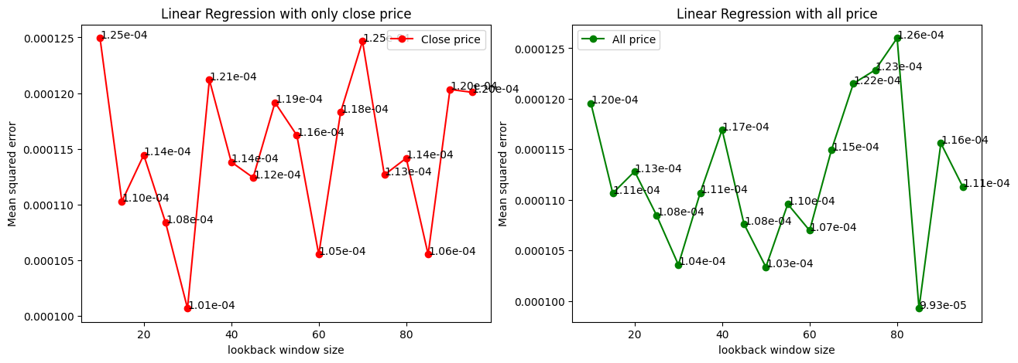
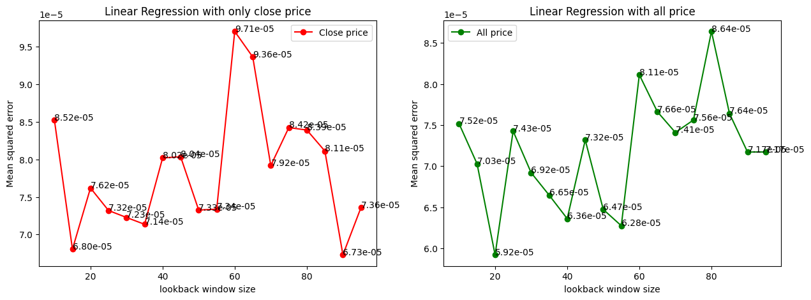
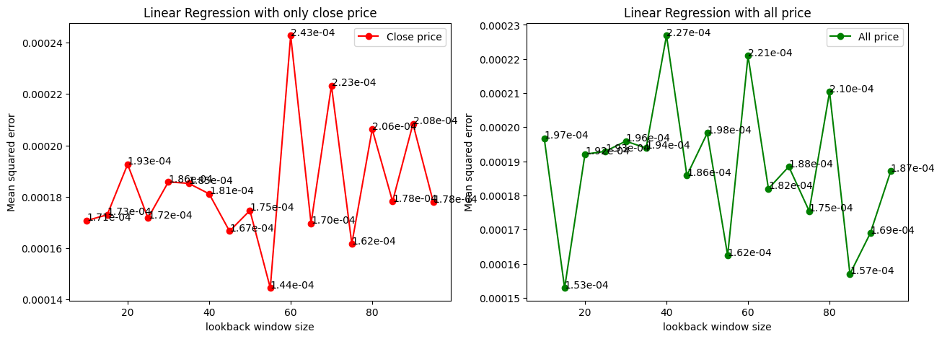
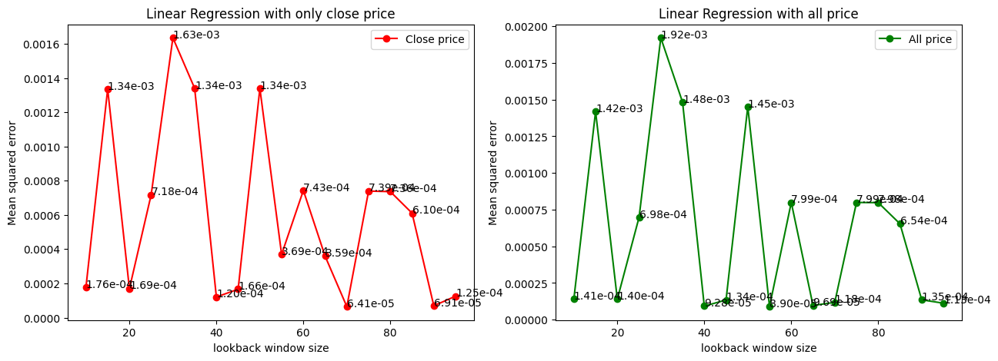
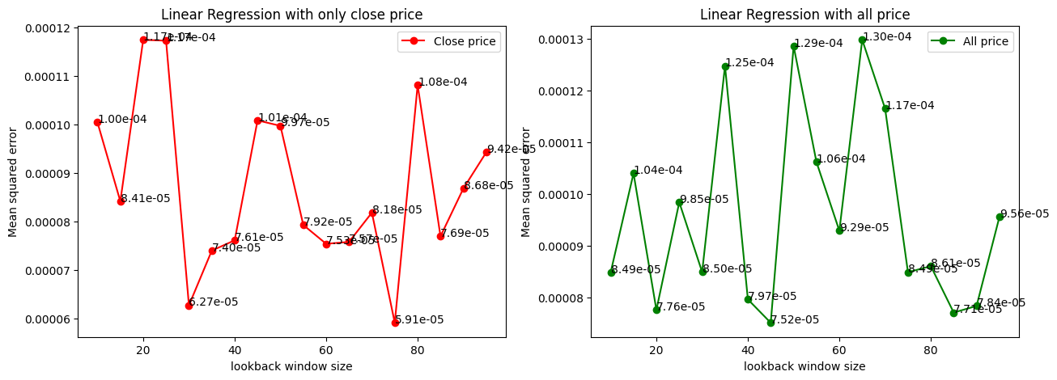
Linear regression for other commodities.
Brent Oil
Gold
Natural Gas
Nickel
Palladium
US Wheat
The model above is best linear regression model for US wheat. Since different commodity has different price distribution, it is necessary to find the model with possible parameter and features separately.

Slide 13
Best linear regression for every commodity
For Brent Oil: Use all price as feature with lookback = 85
For Gold: Use all price as feature with lookback = 20
For Nature Gas: Use close price only with looback = 55
For Nickel: Use close price only with looback = 70
For palladium: Use close price only with looback = 75
For US Wheat: Use close price only with looback = 75

Slide 14
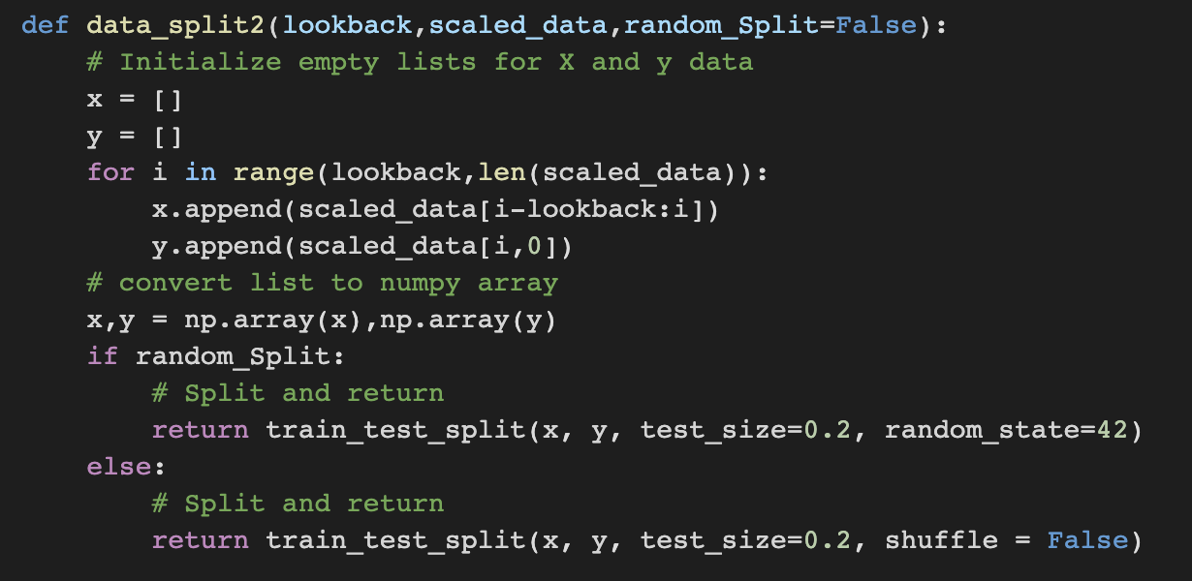
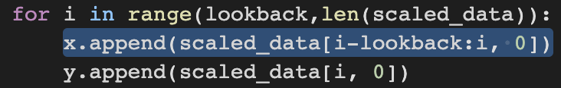
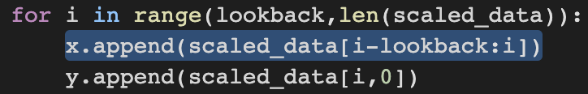
Implement the LSTM model
Firstly, define two functions data_split2() and LSTM_model()
One is for split dataset, the other is about building the LSTM under some controls.
Data_split2():
It is slightly different from the data_split() defined for linear regression model:
Data_split():
Data_split2():
It is because model need the data in shape of like (10,1) instead of in (10,)

Slide 15
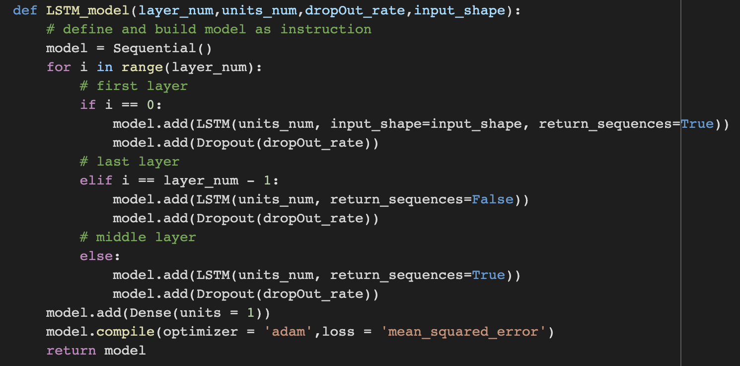
Build the LSTM model
LSTM_model(layer_num,units_num,dropOut_rate,input_shape):
Layer_num: how many LSTM layer + dropout layer there will be.
Units_num: the number of neuron units in one layer.
The dropout rate for the drop out layer
Input_shape: specify the input in first layer for different dataset come.
Finally, a Dense layer to output one-dimension exact price result.

Slide 16
Train LSTM model
The most difficult step is training the model with possible parameter combinations.
All possible parameter:
Lookback:
layer_num:
units_num:
dropout_rate:
Input_shape:
Epoch and batch size:

Slide 17
Train LSTM model
Use GridSearchCV to explore parameter space automatically.
Create and run the GridSearchCV object.
Return the best model for differnt lookback dataset. Use it to predict and return the means squared error as evaluation.
Since the parameter space is in such a high dimensions, it require the hardware and also the time. The result is showing below:

Slide 18
Training and Evaluation of the LSTM model
How shuffled or not affect the training:
Shuffle is one of the way to avoid the overfitting. For this time-series dataset, model will learn some specific rules in some periods. However, it does not have generalization properties for a long time or whole dataset.

Slide 19
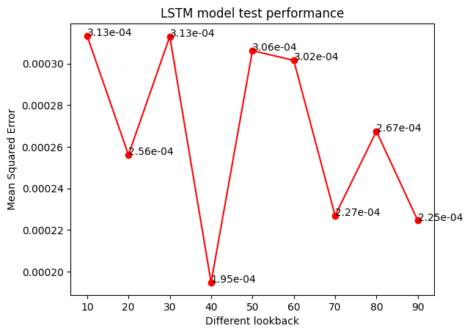
Training and Evaluation of the LSTM model
Feature: only close price data (shuffled both for train and test)
Here is the figures of MSE for every best model with different lookback window size
Best parameter combination is :
The best paramters are {'dropOut_rate': 0.1, 'input_shape': (40, 1), 'layer_num': 2, 'units_num': 150} with lookback = 40

Slide 20
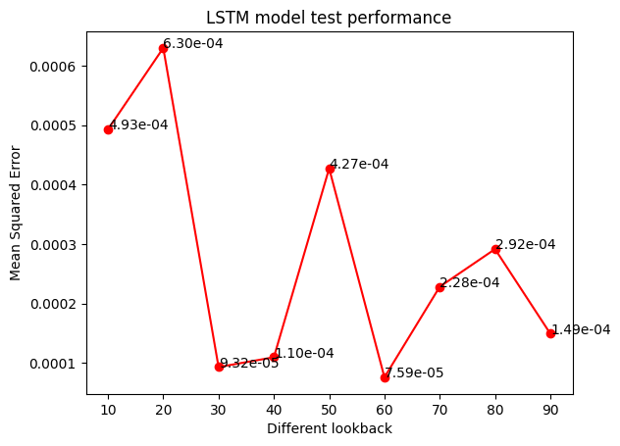
Training and Evaluation of the LSTM model
Feature: all price data (shuffled both for train and test)
Here is the figures of MSE for every best model with different lookback window size
Best parameter combination is :
The best paramters are {'dropOut_rate': 0.1, 'input_shape': (60, 5), 'layer_num': 2, 'units_num': 150} with lookback = 60

Slide 21
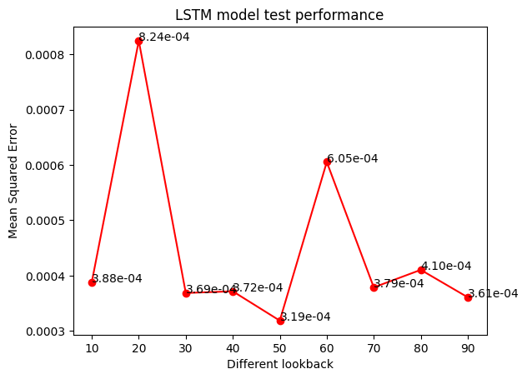
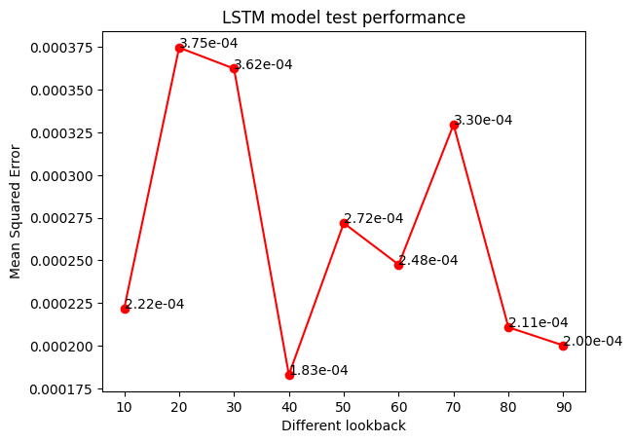
Training and Evaluation of the LSTM model
Here are the figures of MSE for every best model trained with unshuffled data
Close price unshuffled data: The best paramters are {'dropOut_rate': 0.1, 'input_shape': (50, 1), 'layer_num': 2, 'units_num': 150} with lookback = 50
All price unshuffled data: The best paramters are {'dropOut_rate': 0.1, 'input_shape': (40, 5), 'layer_num': 2, 'units_num': 100} with lookback = 40

Slide 22
Conclusion of the LSTM model.
For other commodities:
Do the same things as US wheat since I believe the different price movement or distribution may have the different model for prediction
What I have done:
shuffled data to avoid overfitting
close price or all price as two possible feature
LSTM model structure with specific parameter and feature
More research question:
Produce more features like average price and max gap.
Different lookback and parameters.

